Slide 1

Netflix Recommendations
Final Project – Team Six
Alexander San Filippo
Zack Snyder
Loretta Cortez

Slide 2

Objectives
Using a file of Netflix movie ratings, train a model that will generate movie recommendations based on user ratings.
The inspiration for this project came from reviewing Kaggle.com - we found Netflix previously ran a competition to improve their recommendation algorithm, offering a $1 million prize to the winner.

Slide 3
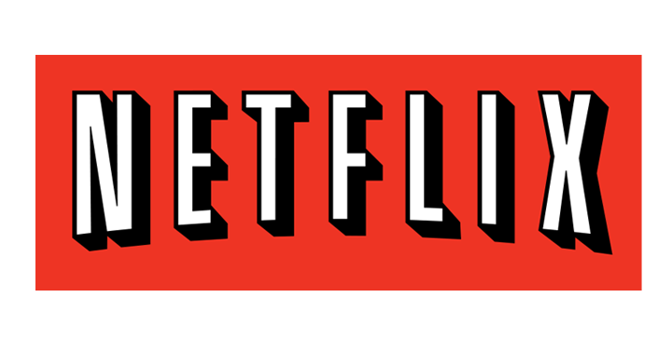
Data
Movie rating files for 17,000+ movie titles, over 100 million ratings from 480,000 random, anonymous Netflix customers.
Data was collected between October 1998 and December 2005.
The ratings are on a scale from 1 to 5 stars.

Slide 4
Data Prep
Utilizing Python Pandas, data was cleaned up to reflect only those fields desired for the model testing.
File sizes exceeded Github allowances, so files were stored on Google Colab: https://drive.google.com/drive/folders/1AYoAIPK5G_vzh7Yu_U_Ap6DcFlYCSw6t
Once data was cleaned, modeling could begin.

Slide 5
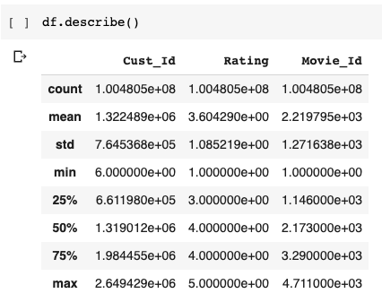
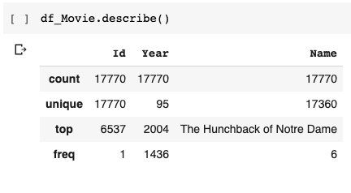
Descriptive Statistics
User Rating Data
Movie Data

Slide 6
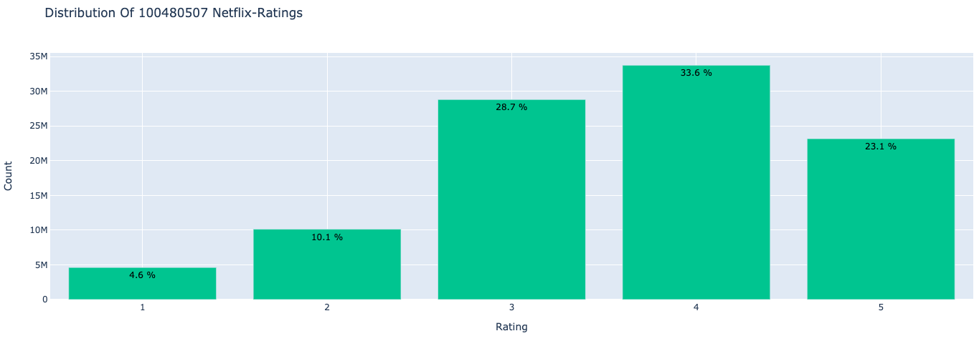
Descriptive Statistics

Slide 7
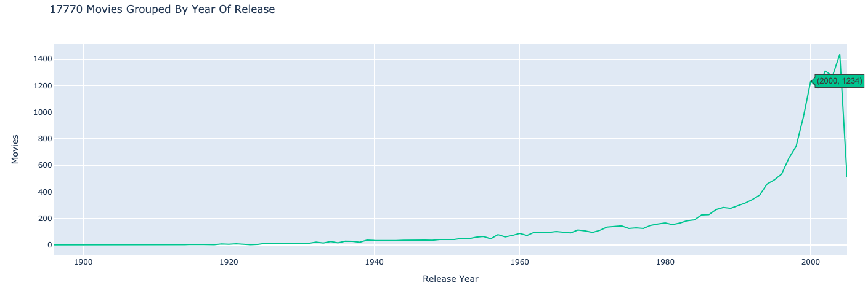
Descriptive Statistics

Slide 8
Modeling
Our team utilized the Scikit Surprise library for modeling.
SurPRISE stands for Simple Python Recommendation System Engine
We used a Singular Value Decomposition (SVD) algorithm to estimate users’ ratings for movies (1 to 5)
We used a KNN algorithm to recommend 5 movies based on a movie given

Slide 9
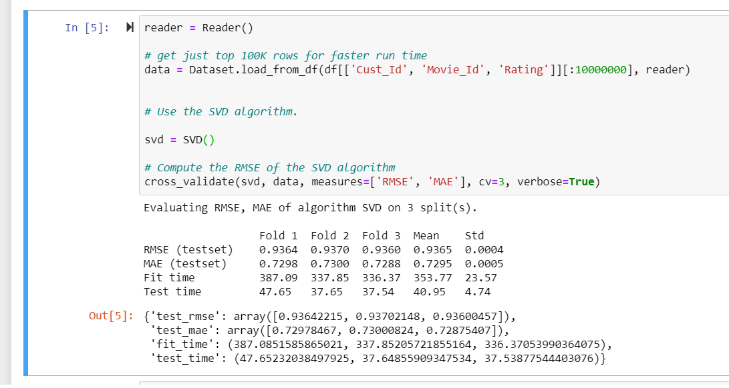
Modeling – SVD (10 Million Datapoints)
Notes:
To initially run the model we ran it on 10 million rows of data. (10% of our data). Took ~ 4 hours
Within surprise there is cross-validation (folds)
As we can see, our RSME is ~1

Slide 10
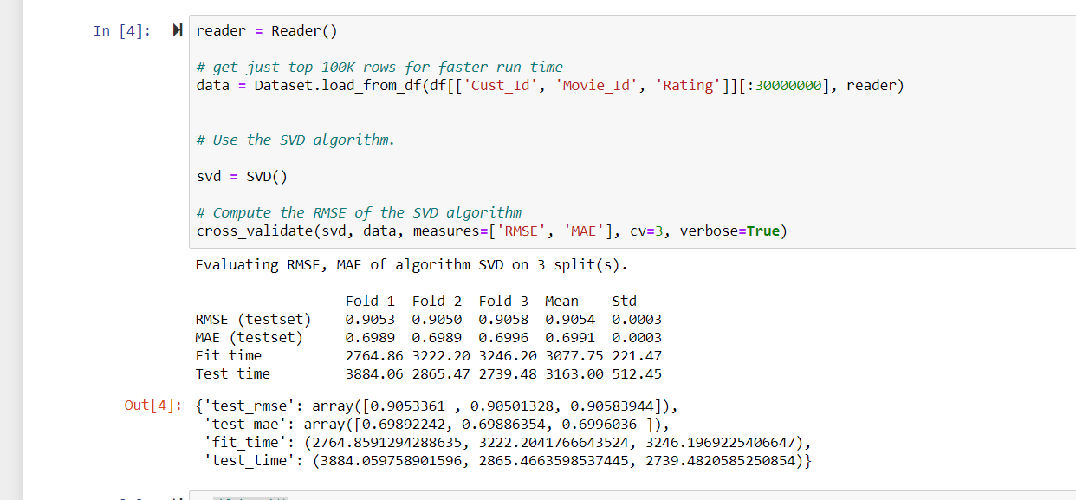
Modeling – SVD (30 Million Datapoints
Notes:
The second run of the model we ran it on 30 million rows of data. (30% of our data). Took ~ 12 hours
Within surprise there is cross-validation (folds)
As we can see, our RSME is lowering as we add more data

Slide 11
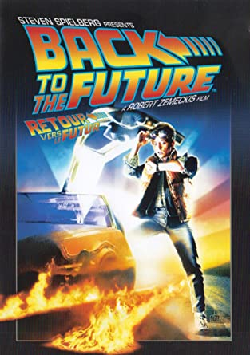


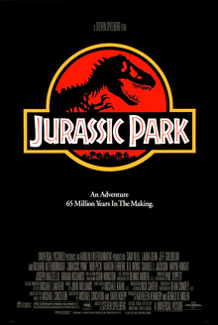


Modeling – KNN Recommendations
“Liked Movie”
“Recommended Movies”

Slide 12
Final Observations
Research into solving the problem prior to jumping into creating our own solution paid off GREATLY
Overall this dataset and methodology was a little too taxing on the computer and slow for it to be a viable solution for Netflix
Especially with Netflix accumulating more and more movies, users, and rating every day
Additionally, the solution of the winner’s in this competition was not actually implemented into Netflix’s rating system due to the increase in usage when switching from DVDs to Streaming

